Slide 1
FORECASTING
STREAMGAGE ELEVATIONS AT USGS NODES
WWW.THOMASOTT.IO
2026 Update — From Research Prototype to an Automated, Deployable Forecasting Platform

Slide 2
CONTENT
01
ABOUT ME
02
THE USE CASE
03
WHY ANOTHER FLOOD PREDICTION PROCESS
04
POMPTON RIVER CROSSING
05
FROM PROTOTYPE TO A PRODUCTION PROBLEM
06
THE FIX: XGBOOST + CONFORMAL CALIBRATION
07
AUTO_PIPELINE.PY — ONE COMMAND, ANY STREAMGAGE
08
PROOF IT GENERALIZES: A SECOND, VERY DIFFERENT RIVER
09
FROM SCRIPT TO PRODUCT: A BROWSER-BASED CONSOLE
10
SHIPPING IT: DOCKER + CONTINUOUS INTEGRATION
11
NEXT STEPS

Slide 3

ABOUT ME
30+ years in Civil Engineering, NJ PE, Machine Learning/Data Science expert, dogs love me.
Engineering consultancy in Northern New Jersey providing Site & Drainage Engineering, Variance Applications, and Green Infrastructure Design.

Slide 4
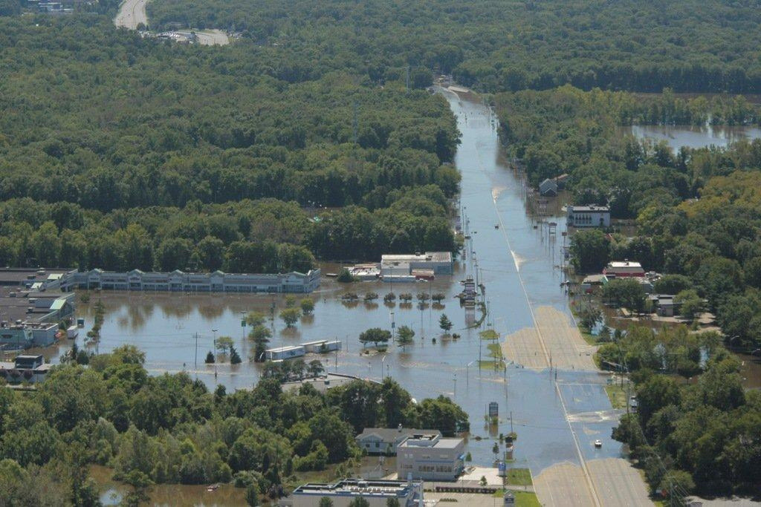
POMPTON RIVER CROSSING
AT ROUTE 23, NEW JERSEY
THE USE
CASE
Wayne NJ August 30, 2011 – Hurricane Irene

Slide 5
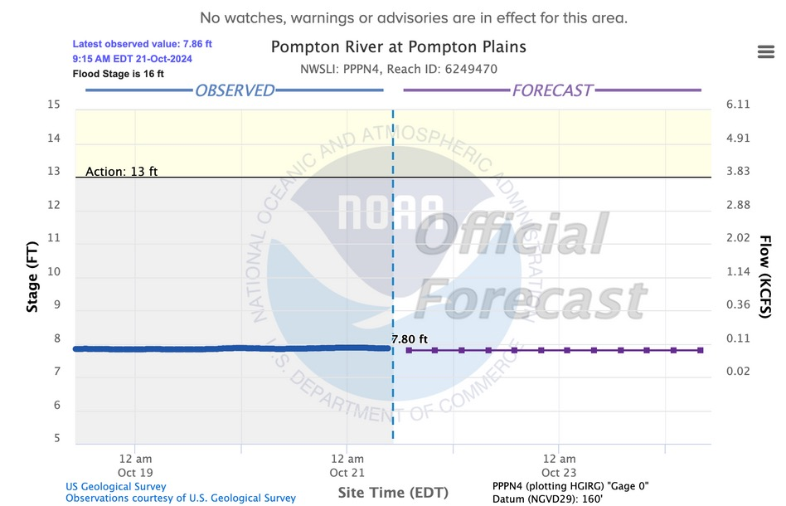
WHY ANOTHER FLOOD PREDICTION PROCESS
NOAA Streamgage
Forecast
Existing flood stage simulations exist already (NWM)*
Why another flood prediction process?
Physics-based vs. data-driven approach
*NWM – National Water Model

Slide 6
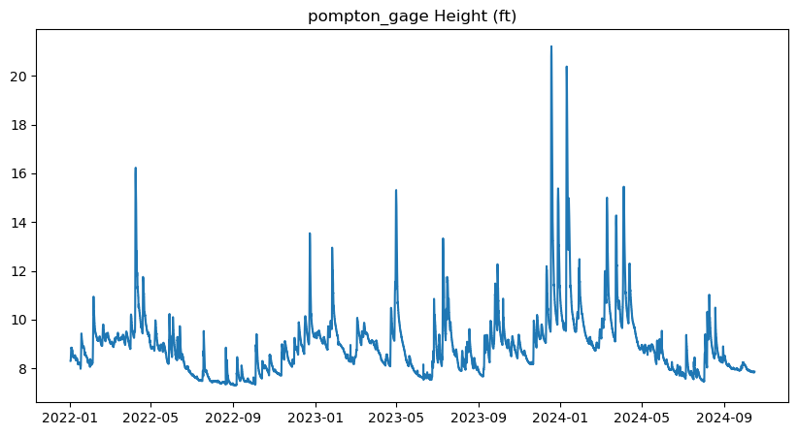
WHY ANOTHER FLOOD PREDICTION PROCESS
USGS Streamgage
Nodes
Why? Apply a data-driven approach for flood predictions
Explore inferencing at the streamgage node — now automated for any site (see “auto_pipeline.py”)
Forecast 1, 3, and 6 hour streamgage elevation using machine learning
Use inferencing results to inform USGS researchers and turn on/off instrumentation remotely
Pompton River gage height, 2022–2024 — the flashy, spike-prone behavior this project targets

Slide 7
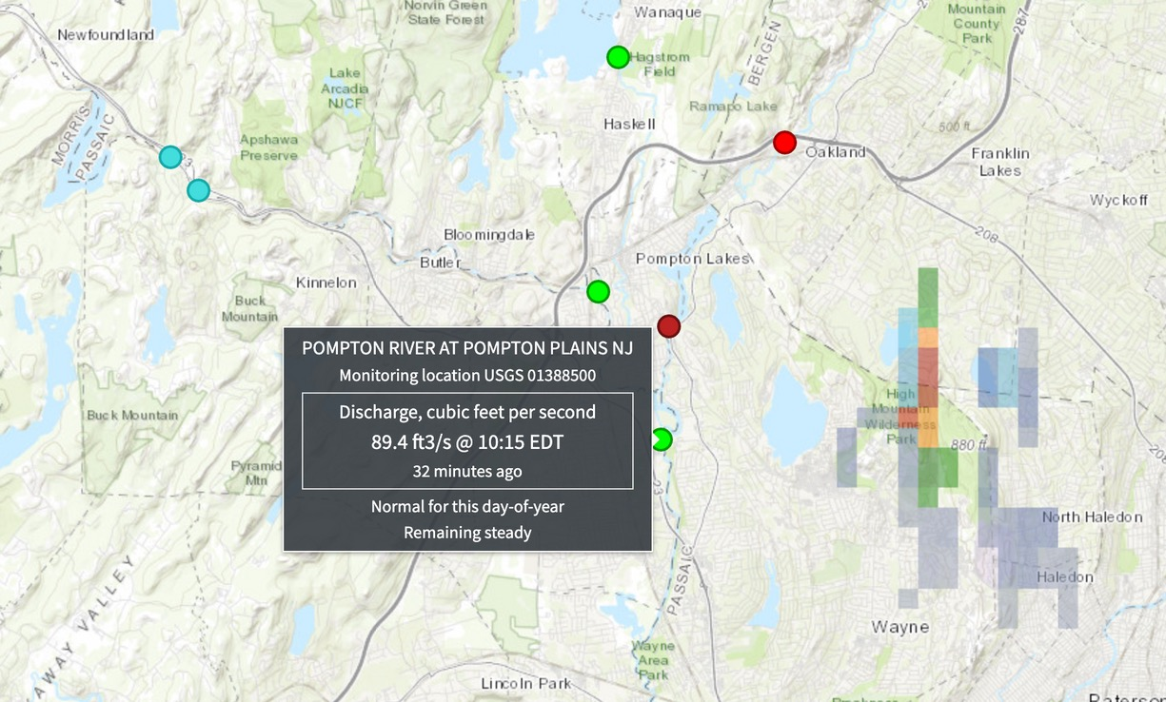
POMPTON RIVER CROSSING – WAYNE NJ
Pompton River crosses at Route 23 in Wayne, NJ
Confluence of Ramapo & Pequannock Rivers just north of the bridge
USGS Streamgage #01388500
Route 23 typically closes at moderate flood stage
Moderate flood stage elevation = 18 feet

Slide 8
FROM PROTOTYPE TO A PRODUCTION PROBLEM
The 2024 approach
AutoGluon TimeSeriesPredictor, “fast_training” preset
Forecast 1 / 3 / 6 / 12 / 24 hours
Best MAE per horizon: 0.002–0.013 ft (Weighted Ensemble / Theta)
What broke in production
Saved models are Python pickle files
Pickle blobs cache numba-JIT'd code paths tied to exact library versions
A routine Python/numba upgrade left production unable to unpickle the saved predictor
Accuracy was never the problem — durability was
The fix couldn’t just be “retrain” — it had to be a model format that survives version upgrades by design.

Slide 9
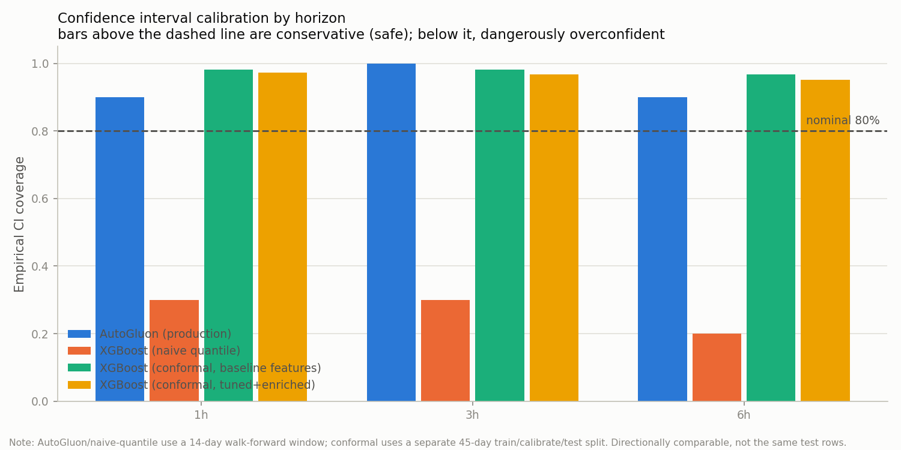
THE FIX: XGBOOST + CONFORMAL CALIBRATION
Two problems, two fixes
Portability → XGBoost’s native JSON save_model() format — a stable, documented schema, not a version-pinned pickle
Calibration → split conformal prediction instead of naive quantile regression
Naive quantile regression dangerously under-covers (as low as ~20–30%); conformal calibration actually delivers its stated 80% confidence level.

Slide 10
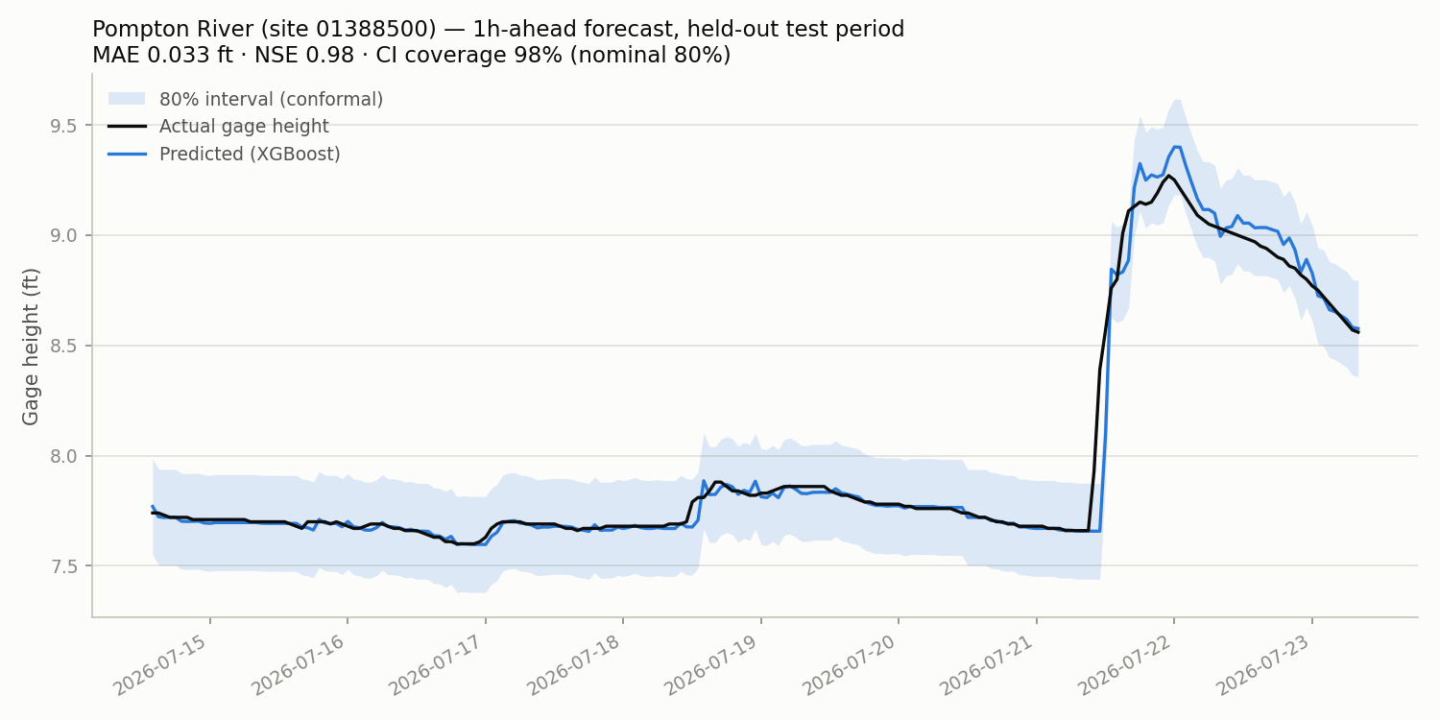
AUTO_PIPELINE.PY — ONE COMMAND, ANY STREAMGAGE
python auto_pipeline.py <site_code> — no more per-site manual trial and error
Discovers genuinely upstream gages via USGS’s NLDI network API (crosses tributary boundaries)
Auto-selects baseline vs. upstream+weather-enriched+tuned features, per horizon, on held-out accuracy
Refits on the full window, saves model.json + metadata.json + a manifest
Real output: Pompton River, 1h-ahead — MAE 0.033 ft · NSE 0.98 · 98% CI coverage (80% nominal)

Slide 11
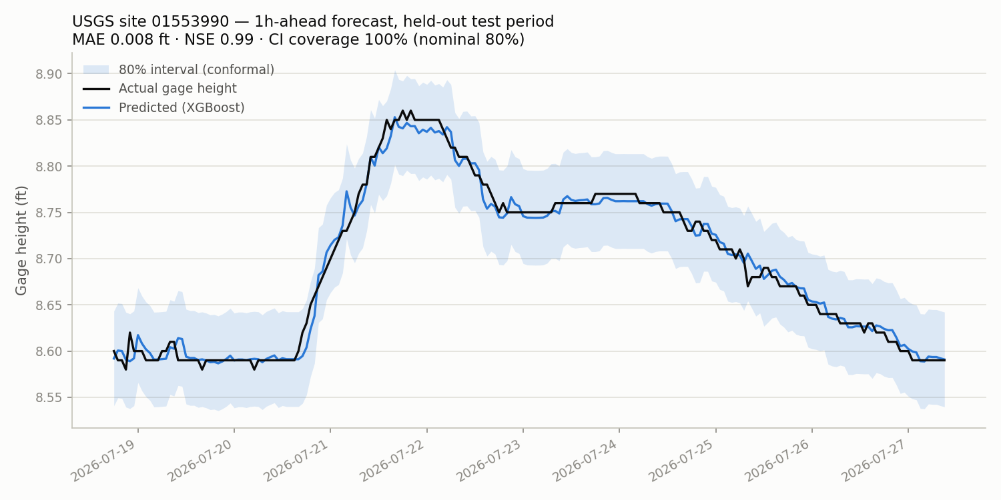
PROOF IT GENERALIZES: A SECOND RIVER
Tested against USGS 01553990 — Susquehanna River above the dam at Sunbury, PA
A dam/impoundment gage: reports gage height, never discharge
auto_pipeline.py detected the missing discharge data and fell back to gage-height-only features automatically — no code change, no manual intervention
Result: MAE 0.008 ft · NSE 0.99 · 100% CI coverage
Real output: Susquehanna above Sunbury dam, 1h-ahead forecast

Slide 12
FROM SCRIPT TO PRODUCT: A BROWSER CONSOLE
Browser
(enter site code)
Go web app
(net/http + SSE log)
auto_pipeline.py
+ charts.py
xgboost_model/
artifacts/
FastAPI
microservice
“Verify” = live
scoring proof
Enter a USGS site code, watch auto_pipeline.py train and charts.py render live over Server-Sent Events — no more staring at a terminal
Click “Verify” to call the microservice’s own routes and prove the new model is really being served, not just that a file exists
Zero external dependencies: Go standard library only, vanilla JavaScript, no framework, no CDN

Slide 13
SHIPPING IT: ONE CONTAINER, FOUR CHECKS
One Docker image
Multi-stage build: Go binary + Python venv + FastAPI service
docker build -t usgs-flood-webapp .
docker run -p 8080:8080 -p 8000:8000 usgs-flood-webapp
Both services start together, stop together
Four GitHub Actions workflows, every push/PR
microservice-tests.yml — pytest, fully mocked
webapp-tests.yml — gofmt / vet / build / test -race
docker-build.yml — builds the image, smoke-tests live predictions
auto-pipeline-tests.yml — trains a real site against live USGS/NLDI/OpenMeteo APIs

Slide 14
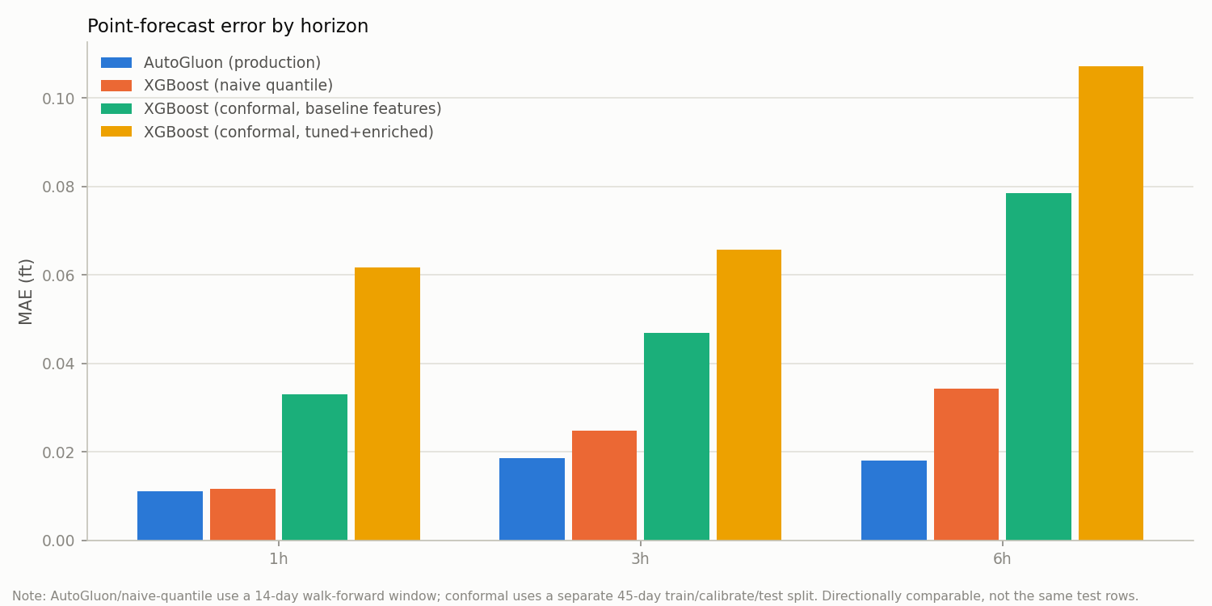
RESULTS: ACCURACY VS. RELIABILITY
AutoGluon’s raw accuracy was never the issue. XGBoost + conformal trades a little point-forecast MAE for a model format that survives a Python upgrade and a confidence interval that actually holds its stated coverage.

Slide 15
NEXT STEPS
Shipped since the last version
Auto-training templates for any streamgage (auto_pipeline.py)
Browser-based training + inference console
One-command Docker deployment
Continuous integration on every push/PR
What’s next
Validate memory/CPU footprint on Raspberry Pi / low-power edge hardware
Expand auto-training across more USGS watersheds beyond NJ/PA
Feed “Verify” results back into USGS researcher tooling for remote instrumentation control
Revisit longer horizons (12h+) only where NSE actually supports it

Slide 16
THANK YOU
Q&A
Contact:
Thomas N. Ott, PE
phone: 973-750-8877
email: info@thomasott.io

